Slide 1
OPE
Inverted Marcus Regime

Slide 2
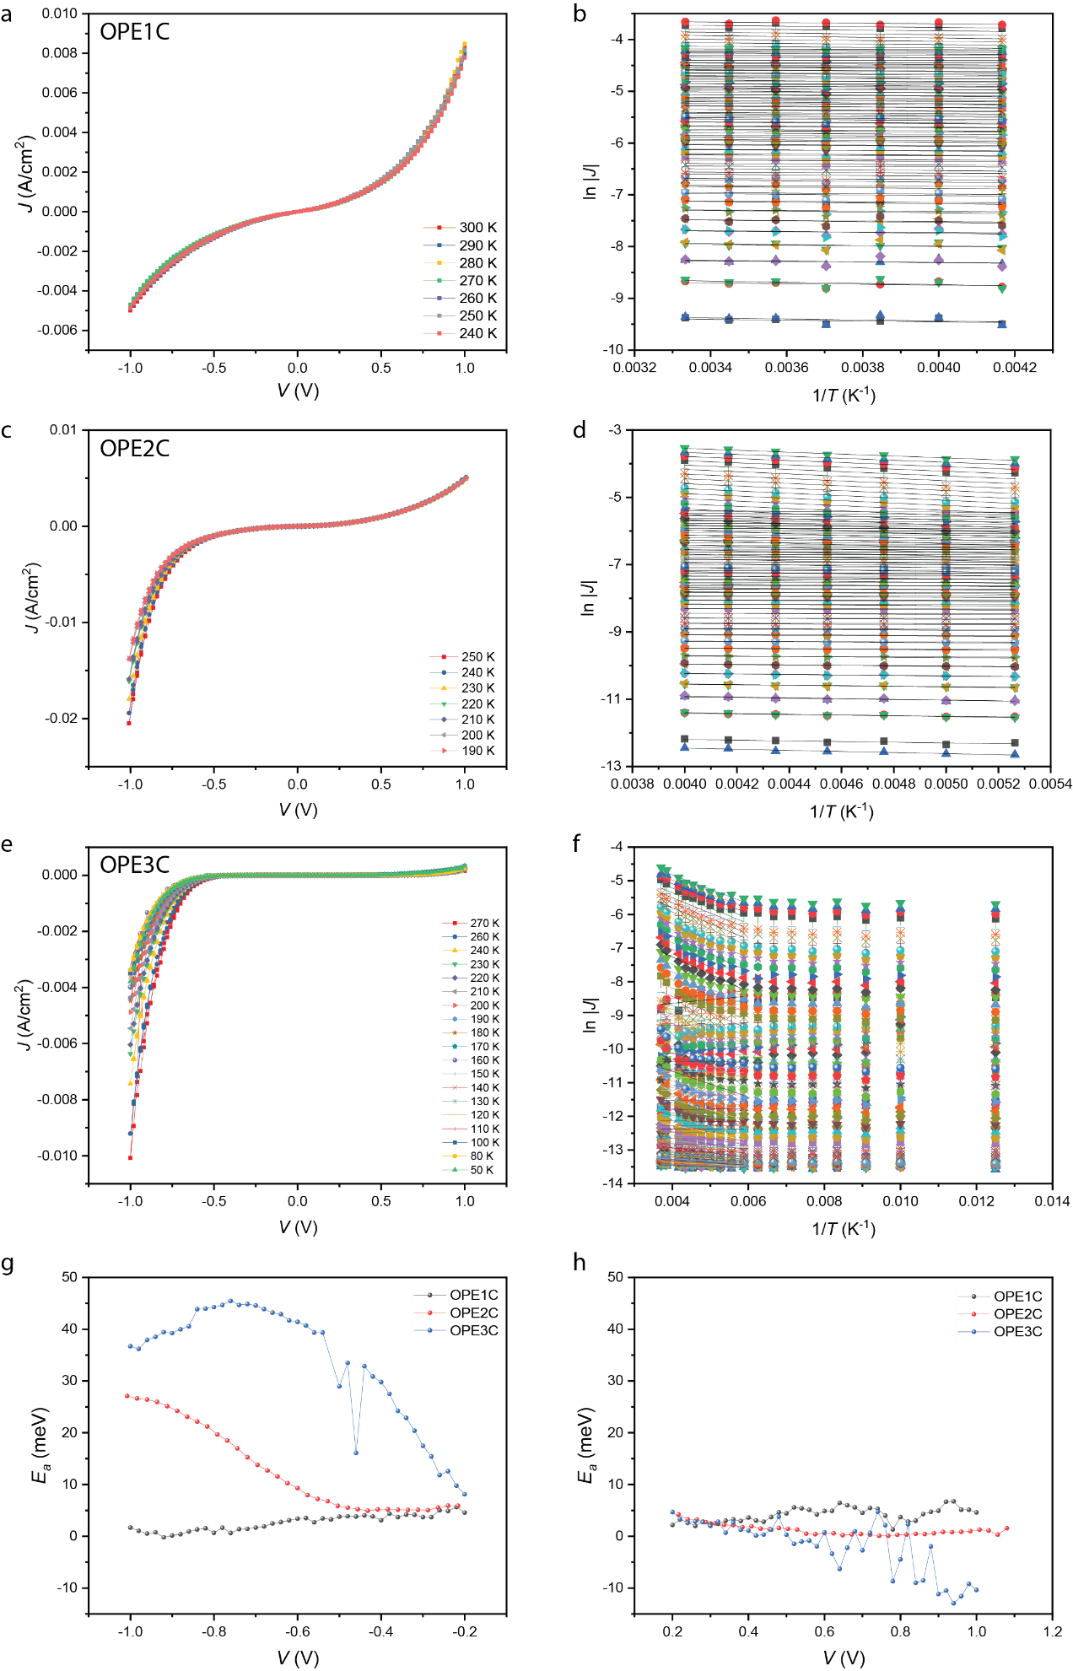
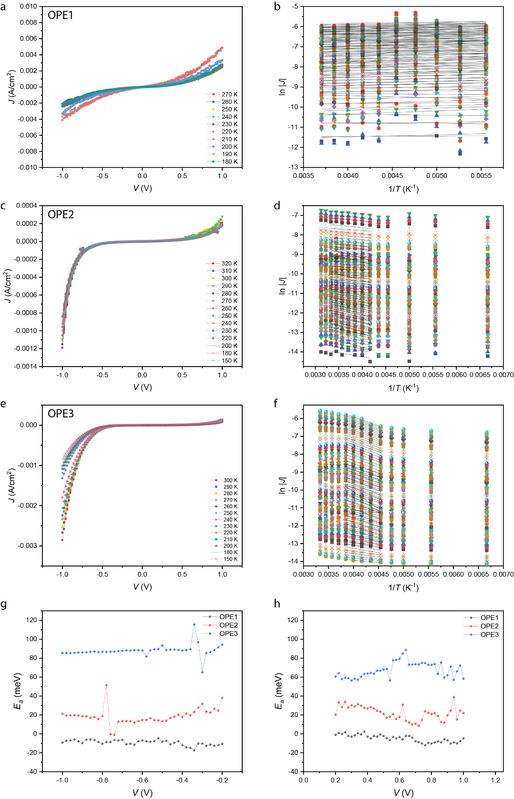
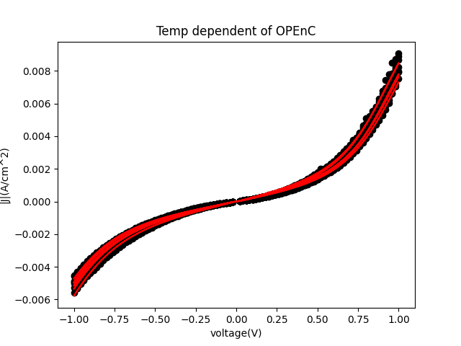
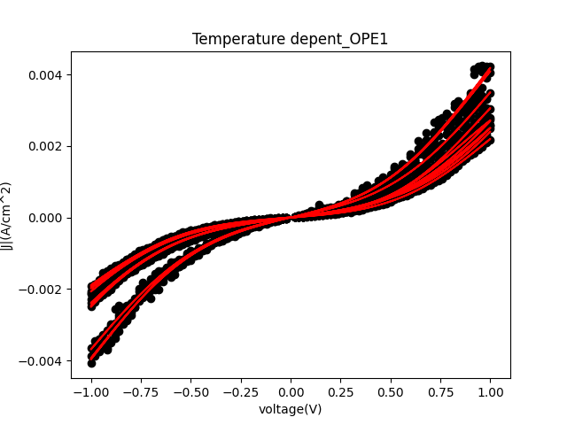
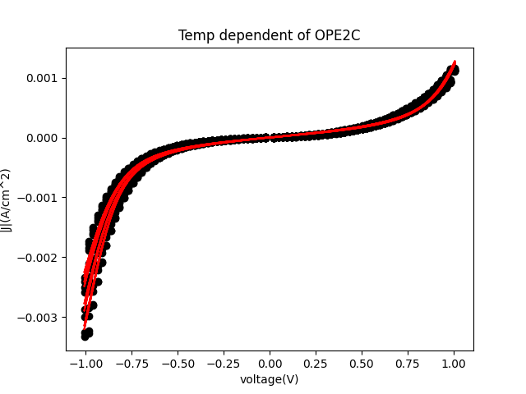
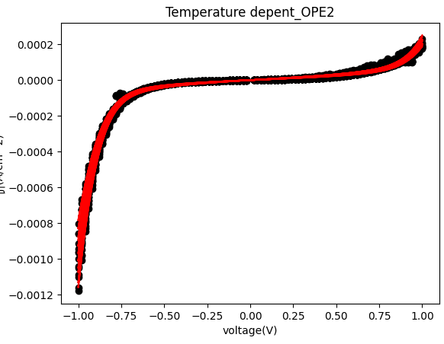
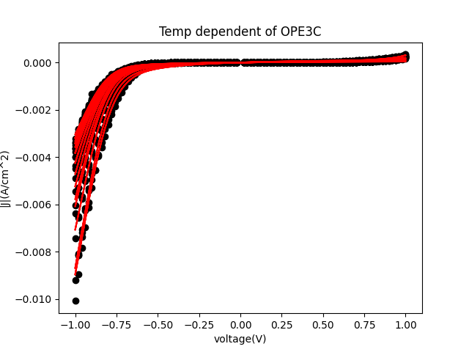
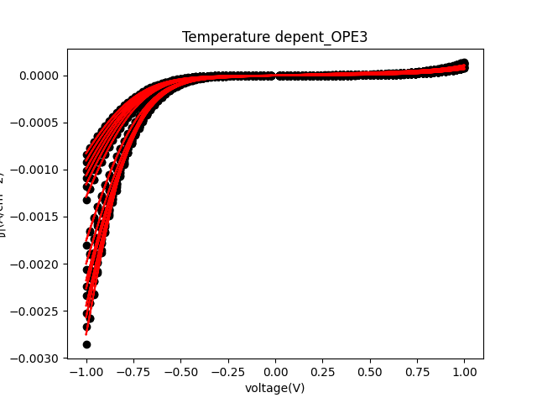
Current Density Data
Francis was able to fit all current density data with great agreement. The results of these fits helped to inform the fitting parameters used to fit the activation energy

Slide 3
Activation Energy Data
Here we focused on the top left, since no effect is seen in the other three panels.

Slide 4
OPEC
Results of the fits show that as n increases, the difference in energy between the two parabolas decreases, while the reorganization energy increases. Also, the charging characteristics change as well. The capacitance and charging position increase.

